Slide 1



Retail Analysis
View in Power BI
Last data refresh:
11/8/2022 4:35:18 PM UTC
Downloaded at:
11/8/2022 4:39:50 PM UTC

Slide 2
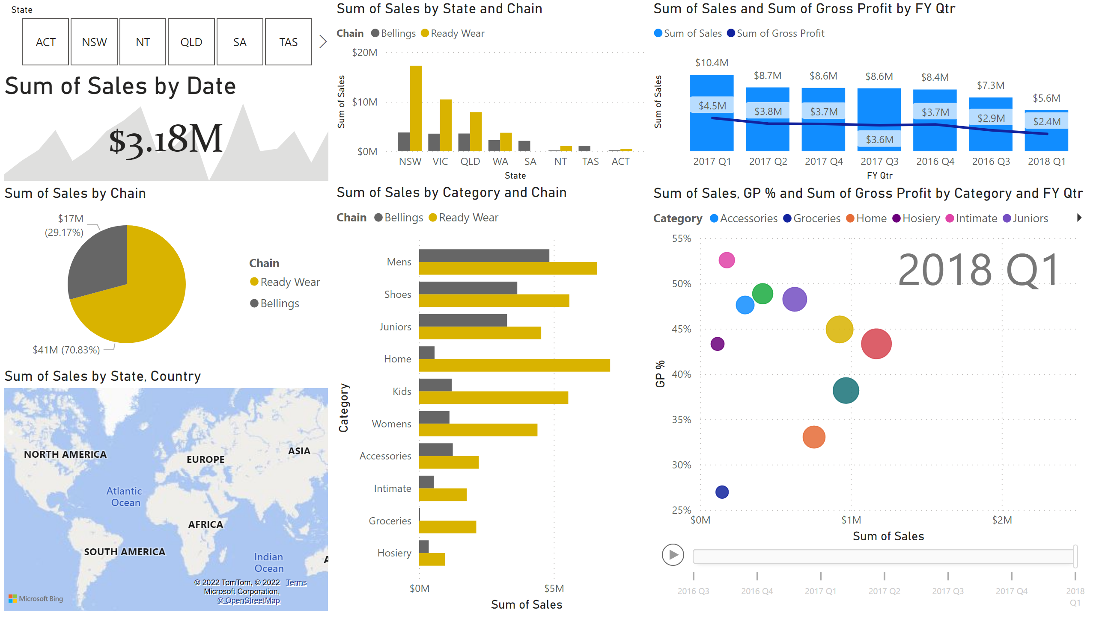
Sales Dashboard1
Notes:
kpi
No alt text provided
clusteredColumnChart
No alt text provided
lineClusteredColumnComboChart
No alt text provided
pieChart
No alt text provided
filledMap
No alt text provided
clusteredBarChart
No alt text provided
scatterChart
No alt text provided
slicer
No alt text provided

